Slide 1
South Thornlie Primary School
Independent
Public
School

Slide 2
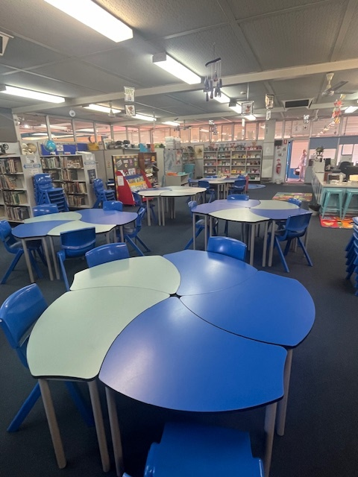
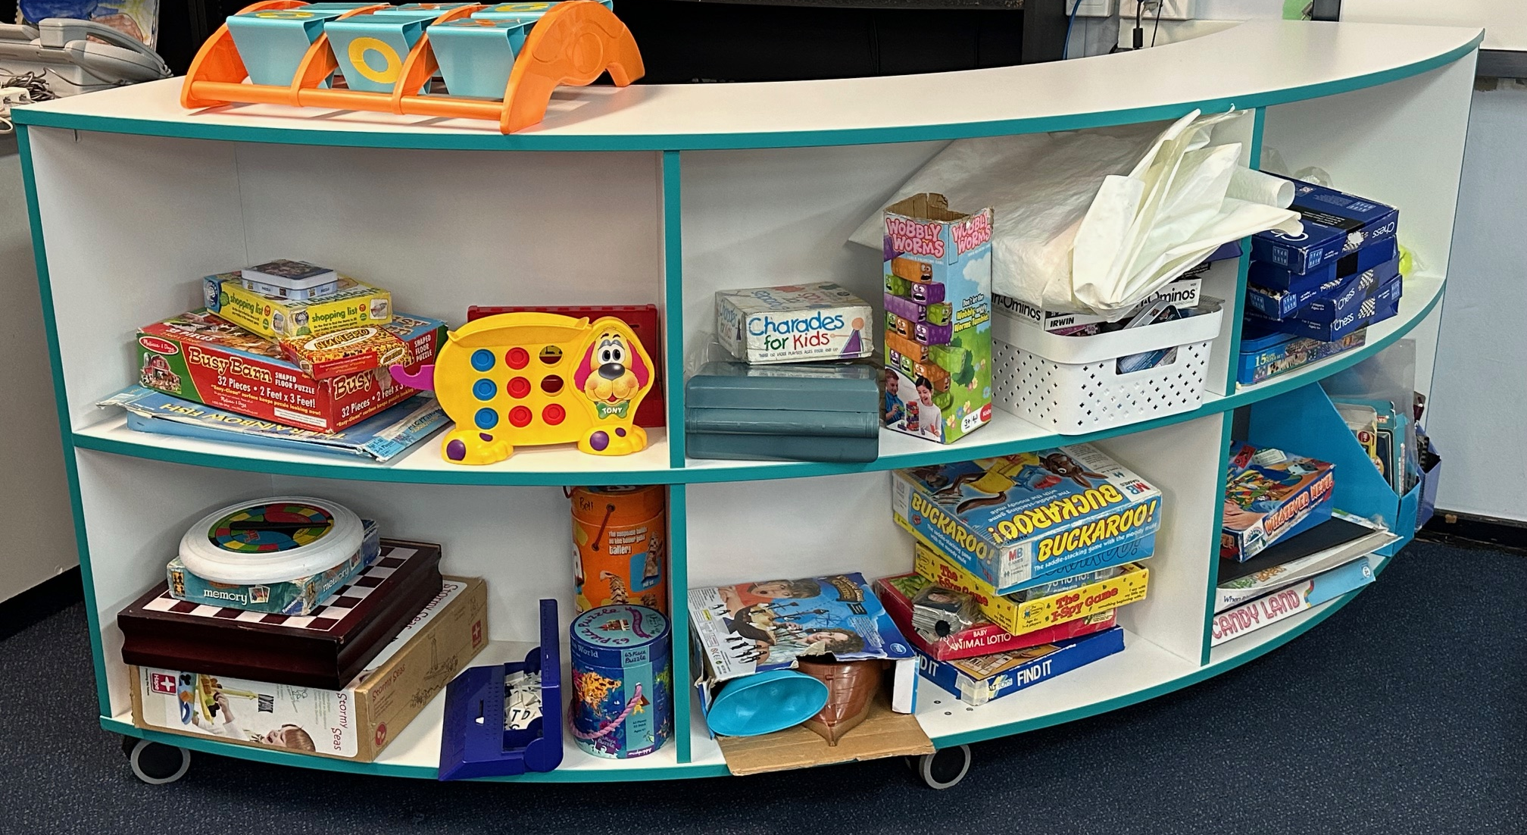
Our library
has new
furniture

Slide 3
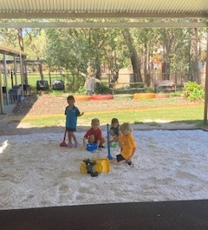
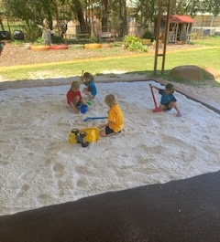
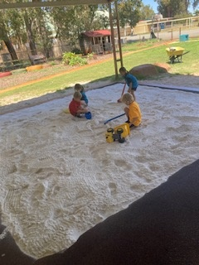
Our busy gardener has rejuvenated our Pre Primary sand pit with sand we received for free from the City of Gosnells
Thanks Mr John

Slide 4
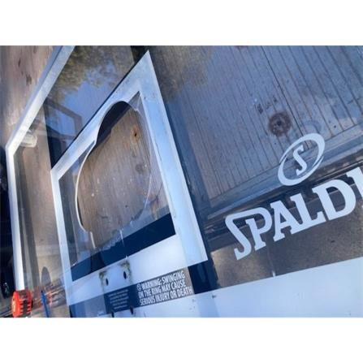
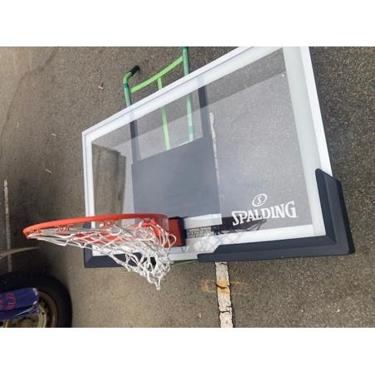
Before
Mr Mattock and Mr John
have repaired the broken basketball backboard.
After

Slide 5
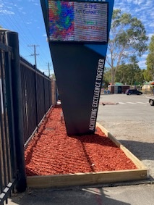
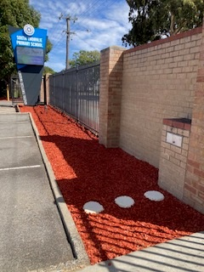
Mr John, our gardener, has been busy over the school holidays.
The entrance around our new sign is tidy and beautiful.

Slide 6
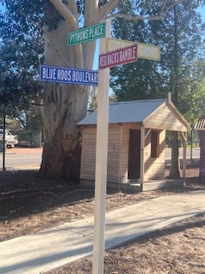
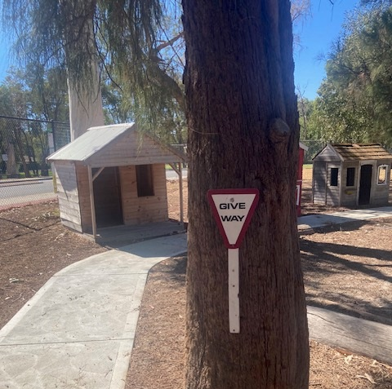
Tiny Town now has some fancy new road signs.

Slide 7
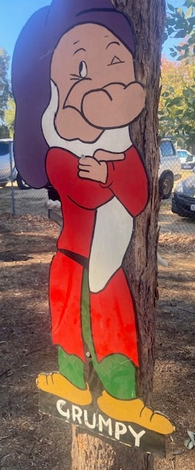
Have a look for new friends in Tiny Town.

